Slide 1


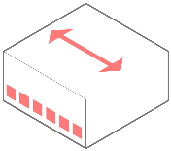




Security Enhancements Using Routers and Switches
Under The Guidance of
Mr. A. Chandrasekhar Sir M.C.A,M.Tech

Slide 2
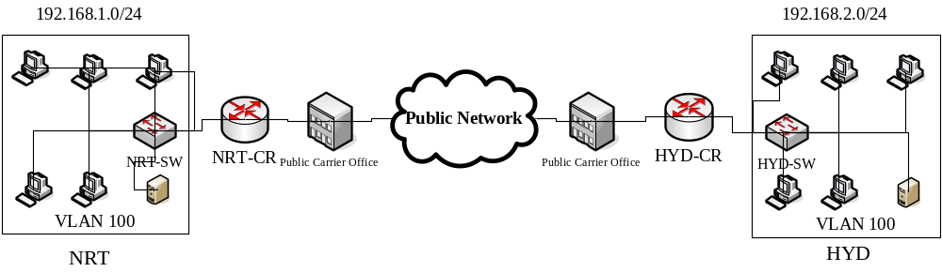
Introduction
Company that have multiple offices need a cost-effective, efficient data exchange between those offices.
Security is also an issue because the one branch must be connected to internet in order to serve multiple locations
Features
  Layout of the network.
  VLSM (Variable Length Subnet Mask).
  VLAN Management.
  Routers Passwords.
  VPN (Virtual Private Networks).

Slide 3
Design
Hierarchical Network Design
  In a hierarchical structure, the network is organized in layers, each of which has one or more specific functions.
IP Subnetting (VLSM)
  Take bits from the host portion of the IP address and reserve them to define the subnet address.
Topology design
  The Topology Design is gives Topology Summary i.e. how the devices are connected.
Connection Layout
  How the physically the devices are connected.
Floor Design
  How the floor in a office are designed.

Slide 4
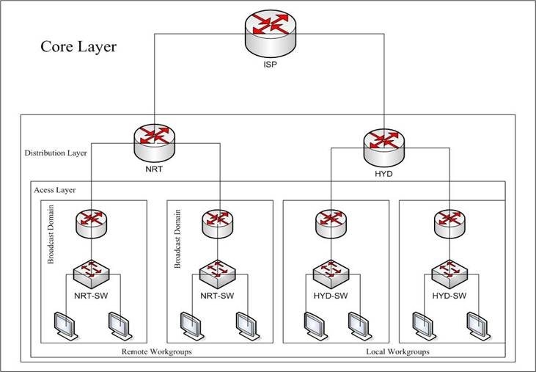
Design (Conti ….)
A hierarchical network design includes the following three layers
  The core layer, which provides optimal transport between sites
  The distribution layer, which provides policy-based connectivity
  The access layer, which provides workgroup and user access to the network.

Slide 5
Design (Conti ….)
The Advantages of hierarchical network are
  Scalability
    Networks that fallow the hierarchical model can grow much layer without sacrificing control .
  Ease of implementation
    A hierarchical design assign clear functionality to each layer, thereby making network implementation easier.
  Ease of troubleshooting
    Because the functions of the individual layers are well defined, the isolation of problems in the network is less complicated.
  Predictability
    The functionality of layers make capacity planning for growth considerably easier;
  Protocol support
    The mixing of current and future applications and protocols is much easier on networks .

Slide 6
Design (Conti ….)
IP Subnetting
  Used in IP networks to break up larger networks into smaller subnetworks
Advantage of IP Subnetting
  Reduced Network Traffic
    With routers, most traffic will stay on the local network; only packets destined for other networks will pass through the router.
  Optimized network performance
    This is a result of reduced network traffic.
  Simplified Management
    It’s easier to identify and isolate network problems in a group of smaller connected networks than within one gigantic network.
  Facilitated spanning of large geographical distances
    Because WAN links are considerably slower and more expensive than LAN links, a single large network that spans long distances can create problems

Slide 7
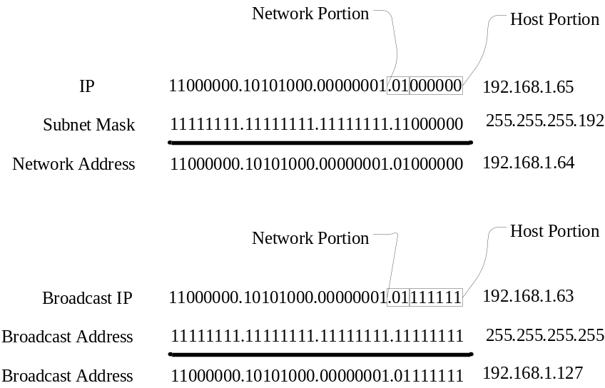
Design (Conti ….)
Subnetting Process
  Subnetting is Converting Host bits to network bits.
  Subnet mask differentiate the network portion and host portion.
  The Network address is represented with all bits as zero in the host portion of the address.
  The broadcast address is represented with all bits as ones in the host portion of the address.
  Valid IP address is lie between the network address and the broadcast address

Slide 8
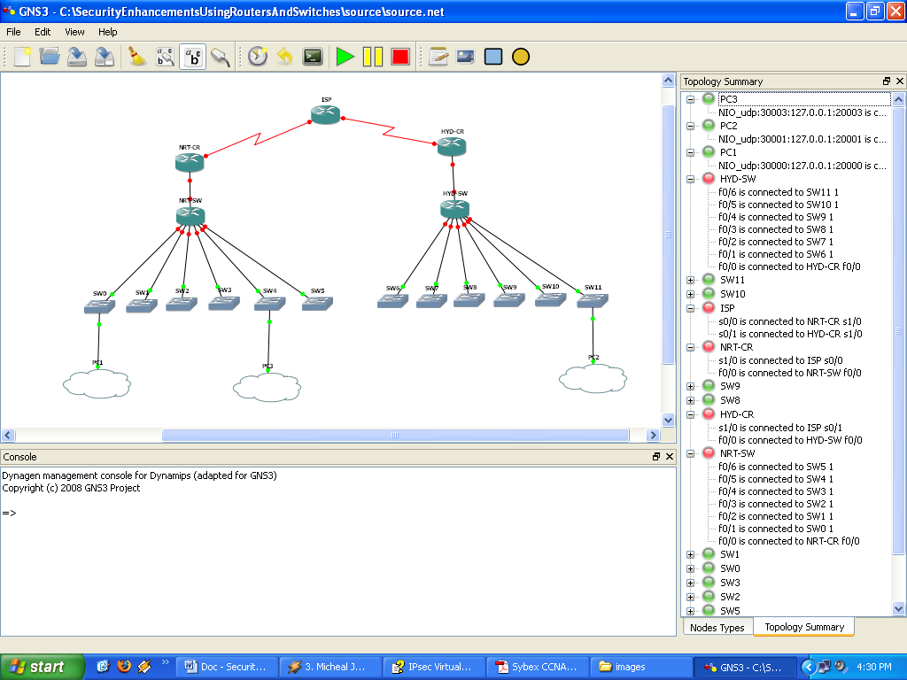
Design (Conti ….)
Topology Design

Slide 9
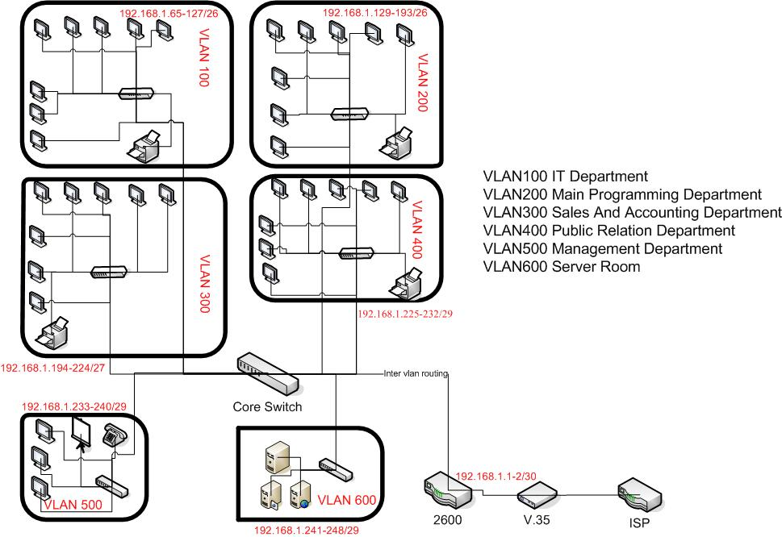
Design (Conti ….)
Connection Layout

Slide 10
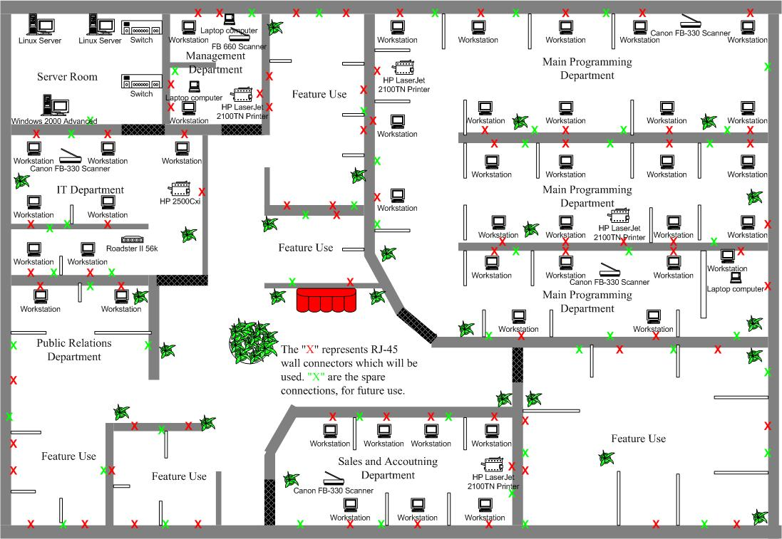
Design (Conti ….)
Floor Design

Slide 11
Implementation
IPsec VPN
  IPsec is an IETF standard that employs cryptographic mechanisms on the network layer.
VLAN
  A Logical of devices on one or more logically segmented LANs
Router Passwords
    Console port
    Telnet
    Secure Shell
    Enhanced username and passwords
IP Subnet Calculator
  The IP Subnet Calculator is used identify the network, broadcast and valid IP address range of a given network.

Slide 12
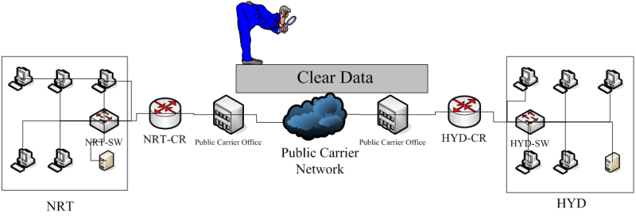
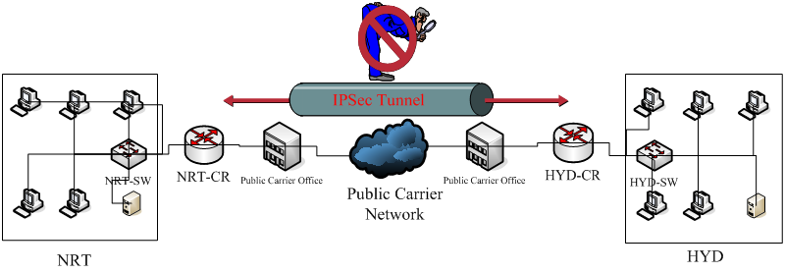
Implementation (Conti ….)
IPsec VPN Features
  Data Confidentiality
    Plain text become cipher text, this can be done by using DES,3DES and AES.
  Data Integrity
    If any modification is happen the packet is dropped, this can be done by using MD5 and SHA.
  Data origin authentication
    Every Out going packet is authenticated, this can be done by using RSA and pre-shared keys.

Slide 13
Implementation (Conti ….)
IPsec uses three main protocols to create a security framework:
  Internet Key Exchange (IKE)
    Provides framework for negotiation of security parameters
    Establishment of authenticated keys
  Encapsulating Security Payload (ESP)
    Provides framework for encrypting, authenticating and securing of data.
  Authentication Header (AH)
    Provides framework for authenticating and securing of data.

Slide 14
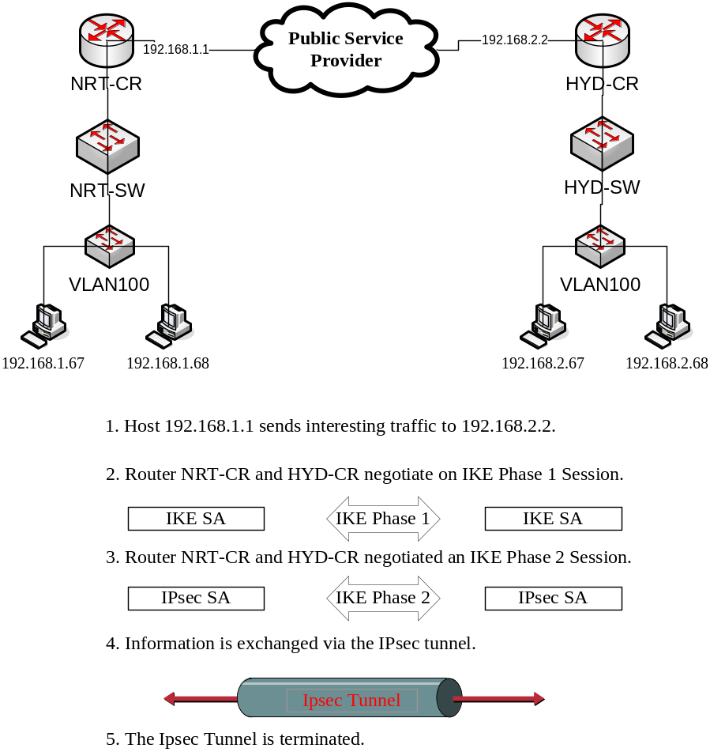
Implementation (Conti ….)
Phase 1
nrt-cr(config)#crypto isakmp policy 1
# authentication pre-shared
# hash md5
# encryption aes 128
# group 2
nrt-cr(config)#crypto isakmp key SeCrEt address 192.168.2.2
Phase 2
nrt-cr(config)# access-list 100 permit ip host 192.168.1.0 0.0.0.255 host 192.168.2.2 0.0.0.255
nrt(config)# crypto ipsec transform-set set1 esp-des
nrt-cr(config)# crypto map map1 10 ipsec-isakmp
# set peer 192.168.2.2
# set transform-set set1
# match address 100

Slide 15
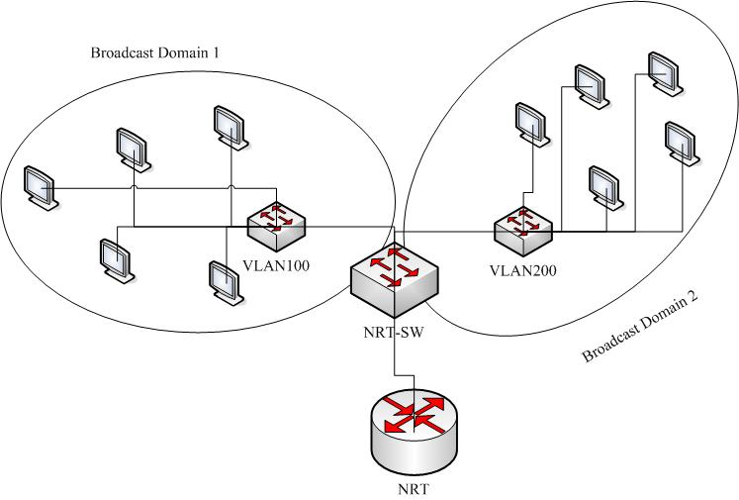
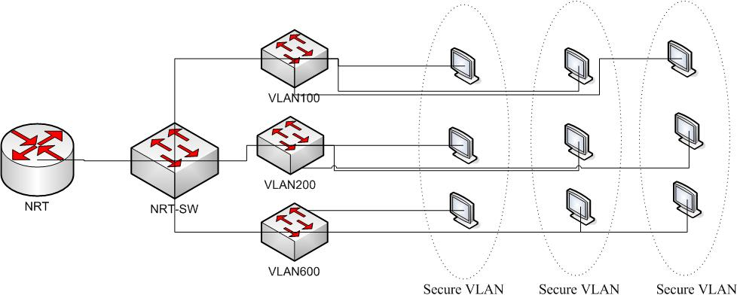
Implementation (Conti ….)
VLAN
  A Logical of devices on one or more logically segmented LANs
Advantage of VLAN
  Change Management
  Broadcast Control
  Security
  Flexibility and scalability

Slide 16
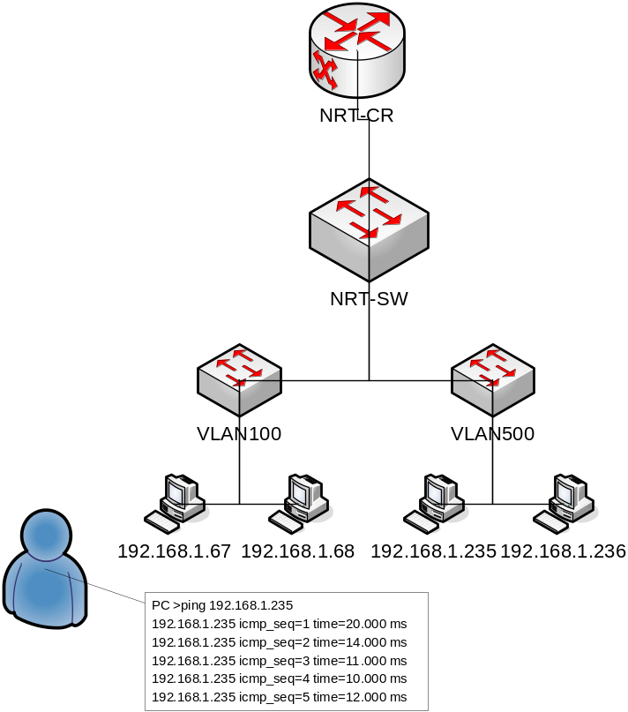
Implementation (Conti ….)
Implementation of VLAN
Implement Inter VLAN Routing
#vlan database
SW(config-vlan)# vlan 100
SW(config-vlan)# name ITDepartment
SW(config)# interface FastEthernet 0/0
SW(config-if)# switchport mode access
Router(config)# interface FastEthernet0/0
Router(config-if)# no ip address
Router(config-if)# interface FastEthernet0/0.100
Router(config-if)# ip address 192.168.1.65 255.255.255.192

Slide 17
Implementation (Conti ….)
Implement Router Passwords
Console Port Passwords
Console Passwords are implemented in global configuration mode
nrt-cr (config) # line console 0
nrt-cr (config-line) # password cisco123
Telent Port Passwords
vty password is for logging via telnet,
nrt-cr (config)# line vty 0 4
nrt-cr (config-line)# password cisco123
Enable password
nrt-cr (config) #enable secret cisco123
Enhanced username and passwords
The enhanced username and passwords are configured in the global configuration mode
nrt-cr (config) # username malli privilege 0 secret cisco123
nrt-cr (config) # username raghava privilege 15 secret cisco123

Slide 18
Implementation (Conti ….)
Configuring SSH
  Configure the IP domain name of your network using the ip domain-name command in global configuration mode:
    nrt(config)#ip domain-name nrt.com
  Generate keys to used with SSH by generating the RSA keys using the crypto key generate rsa command in global configuration mode:
    nrt(config)# crypto key generate rsa general-keys modulus 1024
  Configure the time that the router waits for the SSH client to respond using the ip ssh timeout command in global configuration mode:
    nrt(config)# ip ssh timeout 60
  Configure the SSH retries using the ip ssh authentification-retries command in global configuration mode:
    nrt(config)# ip ssh authentication-retries 4
  enable vty inbound ssh sessions;
    nrt(config)# transport input ssh

Slide 19
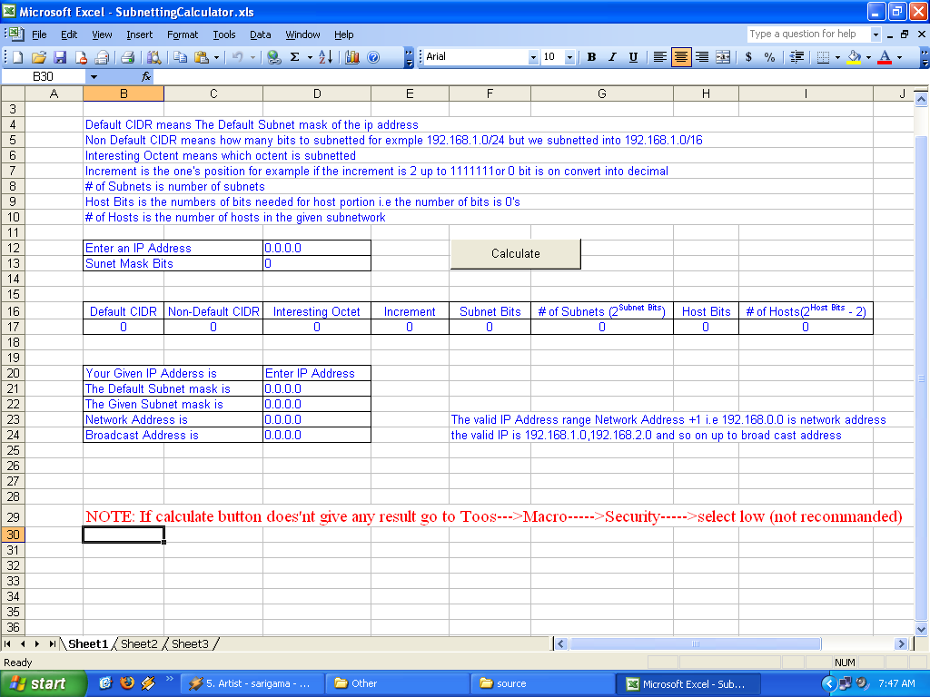
Implementation (Conti ….)
IP Subnet Calculator

Slide 20
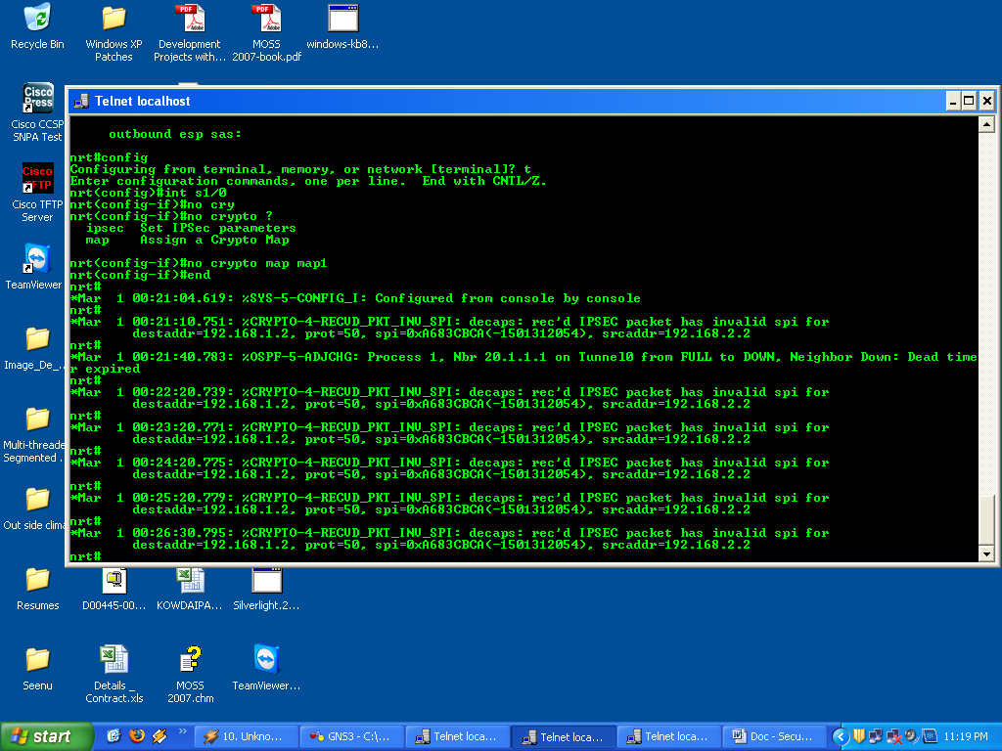
Testing

Slide 21
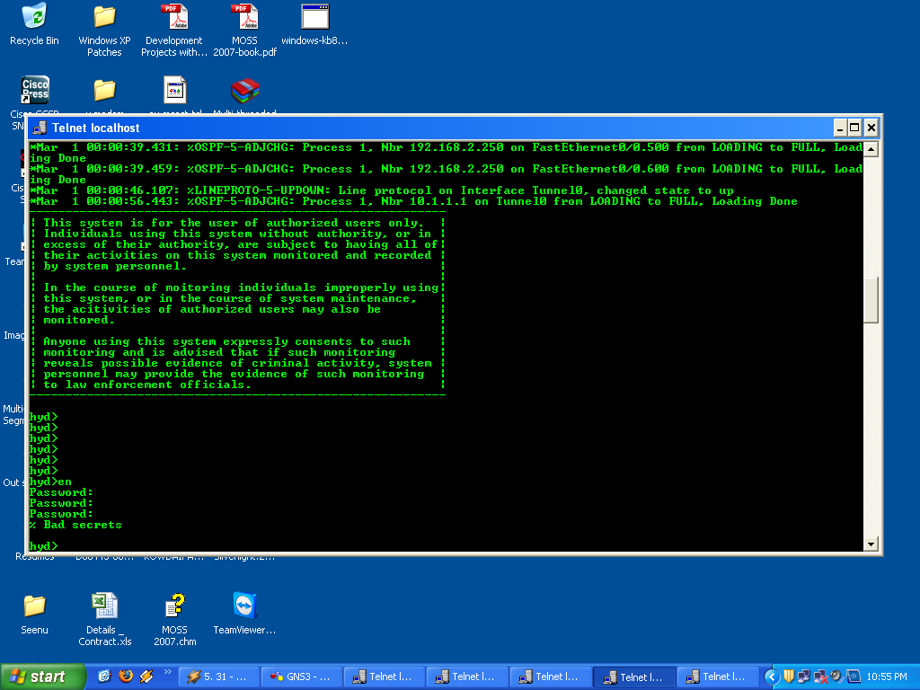
Testing

Slide 22
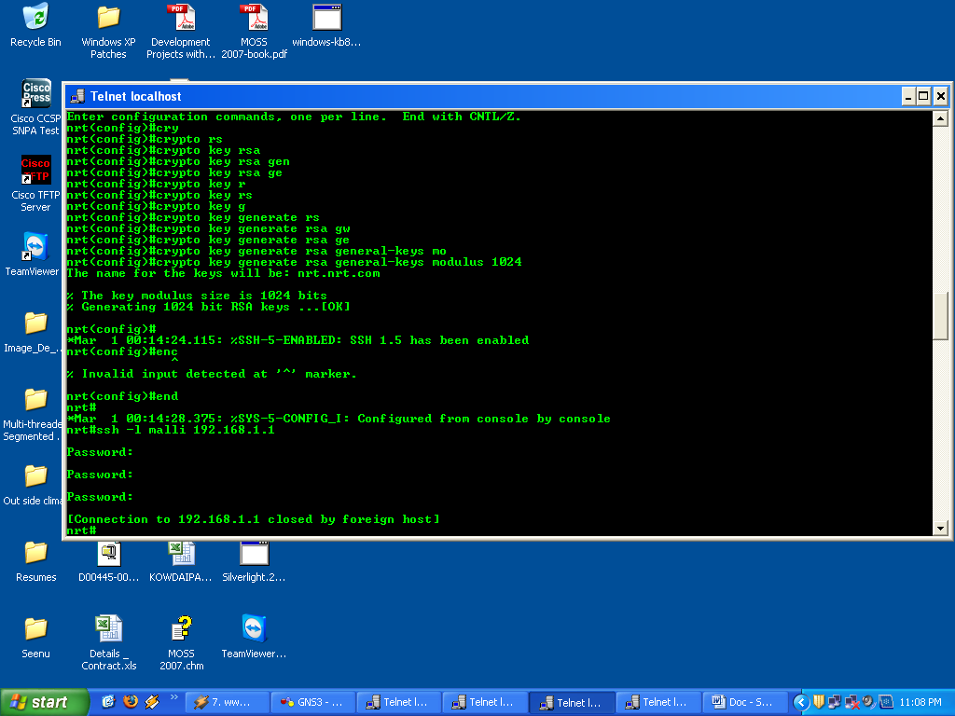
Testing

Slide 23
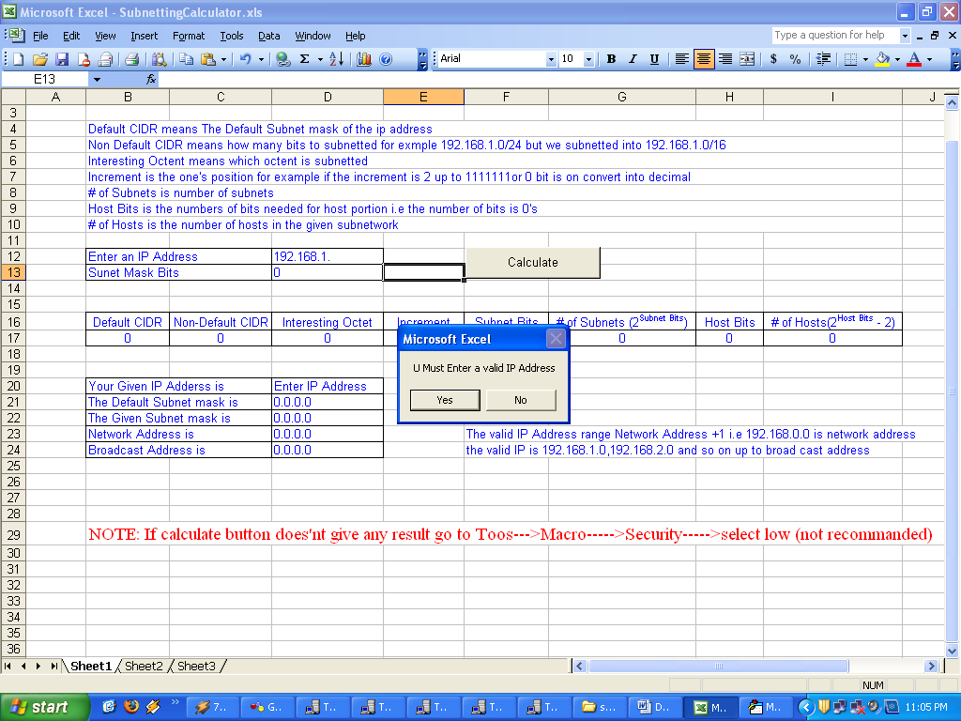
Testing

Slide 24
Screens

Slide 25
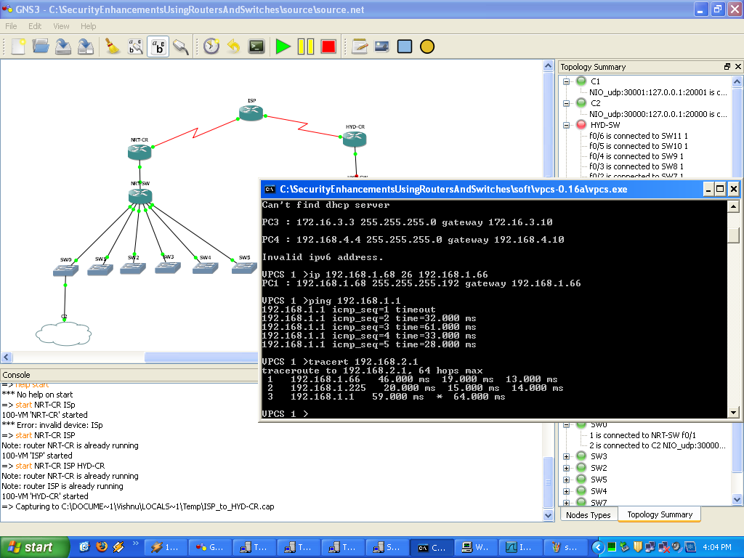
Screens

Slide 26
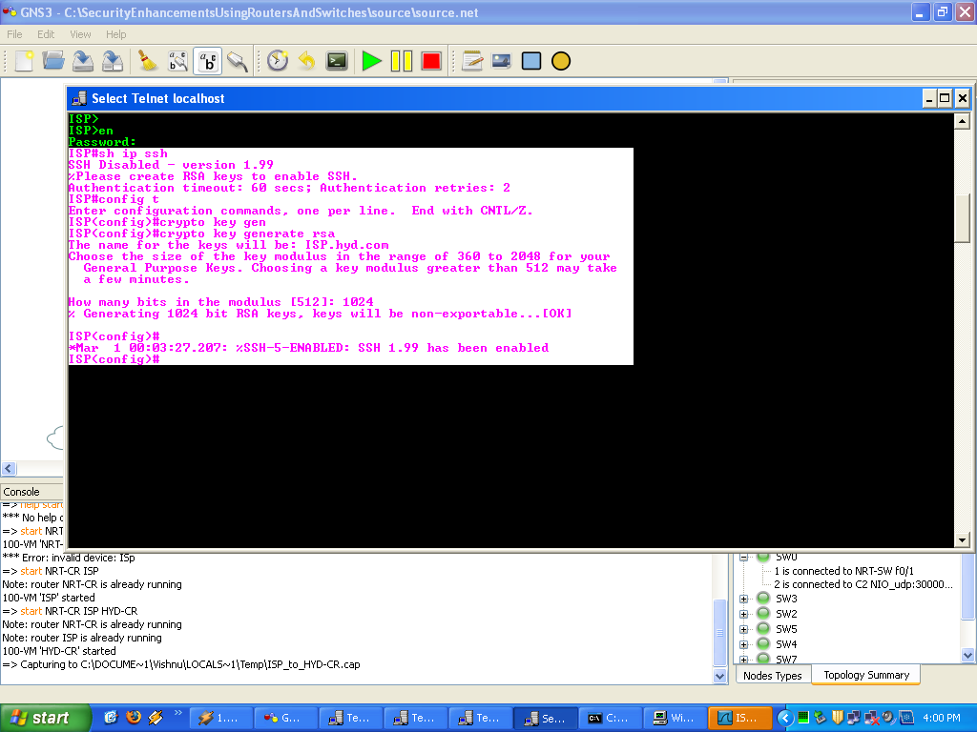
Screens

Slide 27
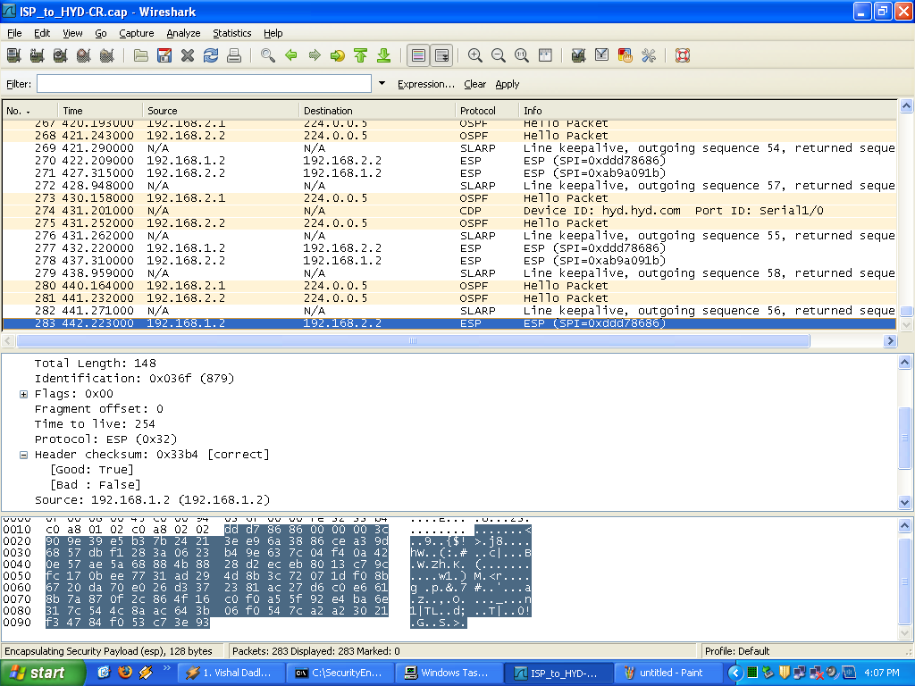
Screens

Slide 28
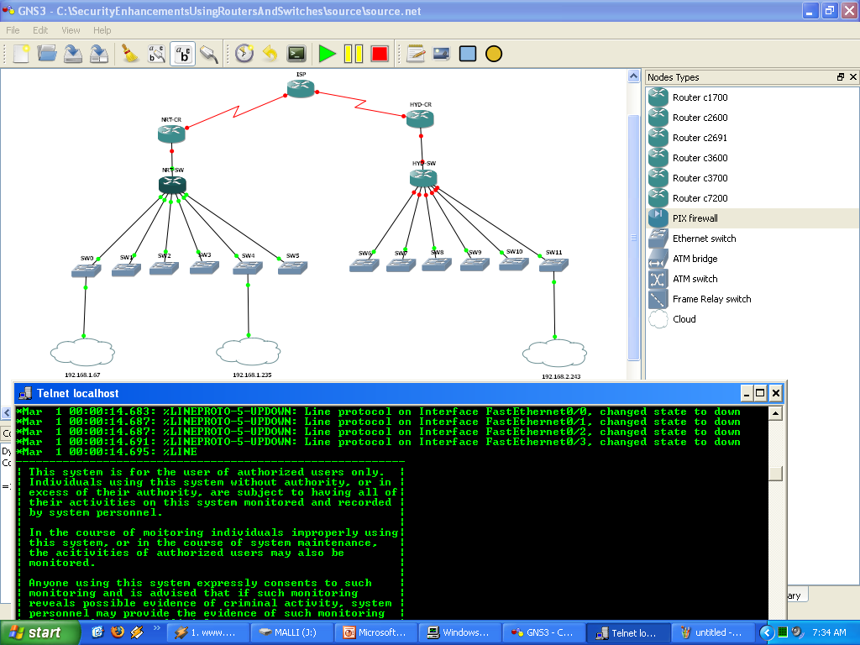
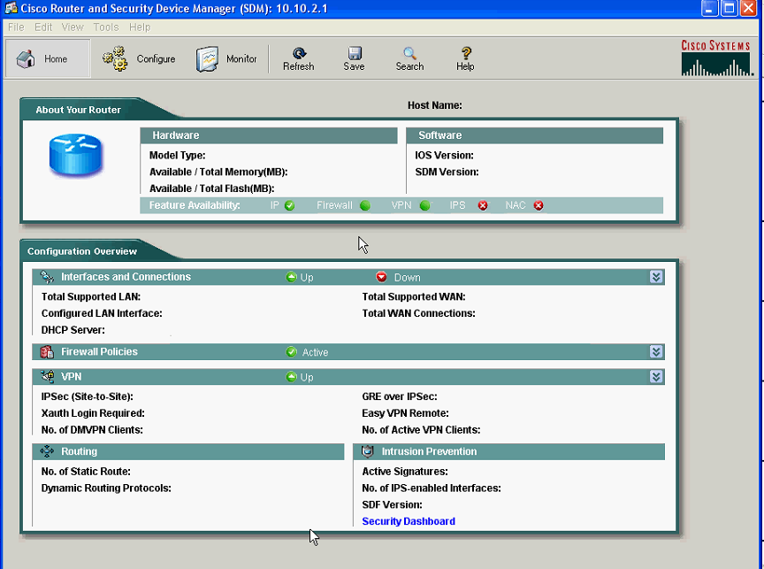
Feature Enhancements
In future add any number of branches to existing network.
In future the routers are configured by GUI.
Further implement redistribution in the network.
In future replace with higher end series routers/switches with old one.
Put a firewall device in future.
Put alarms when ever security violations are occurred.

Slide 29
Conclusion
I can conclude that this project will fulfill all the needs of the users and Any further suggestions, comments are always welcome.

Slide 30
Thank You
Mallikarjunarao

